Slide 1
What is query language?
A query language is a specialized language used to request information from databases or other data sources. It allows users to retrieve, manipulate, and manage data efficiently.

Slide 2
There are two types of query language
1. Procedural Query language
2. Non-procedural Query language

Slide 3
Procedural Query language
It describes step-by-step procedure for computing the desired answer.
Queries are specified in an operational manner. Useful for representing execution plans.
Example: Relational Algebra - conceptual procedural query language used on relational model.

Slide 4
Non - procedural Query language
It describes the desired answer without specifying how the answer is to be computed.
Non - operational, declarative.
Example: Relational Calculus - conceptual non-procedural query language used on relational model.

Slide 5
Let’s take a real-world example to understand the procedural language, you are asking your younger brother to make a cup of tea, if you are just telling him to make a tea and not telling the process then it is a non-procedural language, however if you are telling the step-by-step process like switch on the stove, boil the water, add milk etc. then it is a procedural language.

Slide 6
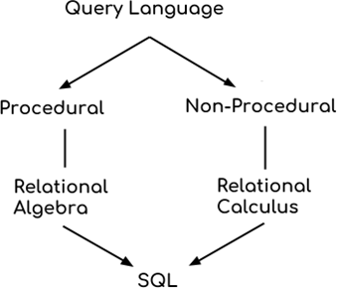

Slide 7
Relational Algebra and Calculus are the theoretical concepts used on Relational Model.
RDBMS is a practical implementation of Relational Model.
SQL is a practical implementation of Relational Algebra & Calculus.

Slide 8
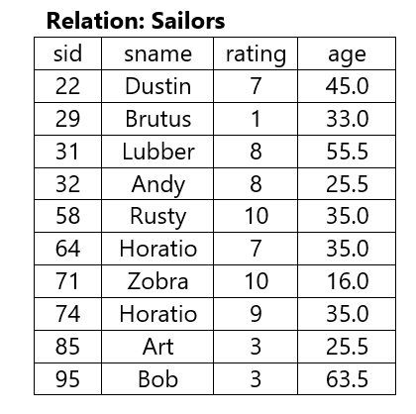
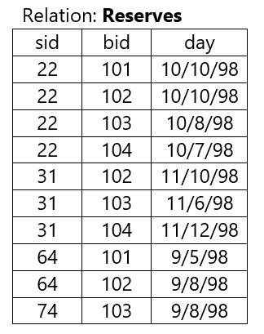
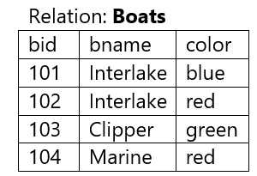

Slide 9
Display the details of sailors who have rating greater than 8.
σ rating > 8 (SAILORS)

Slide 10
Display the details of red color boats.
σ color =’red’ (BOATS)

Slide 11
Display the name and age of all sailors.
∏ sname, age (SAILORS)

Slide 12
Find the names of sailors who have ratings at least 8?
∏ sname (σ rating >=8 (SAILORS))

Slide 13
Find the names of sailors who have reserved boat 103
∏ sname ((σ bid = 103 (RESERVES) ⋈ SAILORS)

Slide 14
Find the sid of sailors who have reserved green boat
∏ sid ((σ color=’green’ (BOATS) ⋈ RESERVES)

Slide 15
Find the names of sailors who have reserved a red boat
∏ sname ((σ color =’red’ (BOATS) ⋈ RESERVES ⋈ SAILORS)

Slide 16
Find the colors of boats reserved by Lubber
∏ color ((σ sname =’Lubber’ (SAILORS) ⋈ RESERVES ⋈ BOATS)

Slide 17
Find the names of boats reserved by Dustin
∏ bname ((σ sname =’Dustin’ (SAILORS) ⋈ RESERVES ⋈ BOATS)

Slide 18
Consider the following schemas
Suppliers(sid:integer, sname:string, address:string)
Parts (pid:integer, pname:string, color:string)
Catalog (sid:integer, pid:integer, cost:real)
Based on the above schemas, write the corresponding relational algebra queries for the following.
i) Find the names of suppliers who supply some red part.
ii) Find the names of suppliers who supply some red part or green part.
iii) Find the sids of suppliers who supply every part.
iv) Find the pids of parts supplied by supplier from chennai.
V) Find the pids of parts supplied by every supplier at less than $200

Slide 19
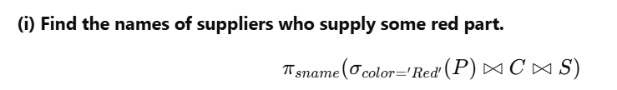

Slide 20


Slide 21


Slide 22
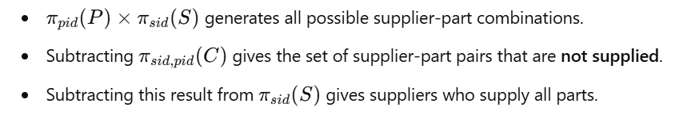

Slide 23


Slide 24
